Slide 1
Sort Tips – V2.0

Slide 2
SORT re-fresh
SORT
  To arrange a collection of records in some specified order. One of these fields is designated as the "sort key" which means the records will be ordered according to the value of that field. SORT ordering can be ascending or descending.
INCLUDE
  It is used to specify the conditions for inclusion of records from the input file during processing.
OMIT
  It is used to specify the conditions for exclusion of records from the input file during processing.
  Both INCLUDE and OMIT cannot be used together.

Slide 3
SORT re-fresh
INREC
  It is used to re-format the input records before SORT/MERGE process.
OUTREC
  It is used to reformat the processed records into the required layout to the output file.
MERGE
  It is used merge two or more pre-sorted datasets. This statement requires the sort sequence for the data. The list of fields and their formats must be specified for this statement.

Slide 4
SORT re-fresh
SKIPREC
  It is used to skip the first n records from the input file before doing any SORT processing.
  E.g:
    SKIPREC=20 specifies that the first 20 records from the input file will be skipped for processing.
STOPAFT
  It is used to include the first n records for SORT processing.
  E.g:
    STOPAFT=100 specifies that the first 100 records from the input file will be processed and rest of the records will be ignored/excluded for processing.

Slide 5
SORT re-fresh
SUM
  It is used to summarize data based on the SORT statement.
  One record will be produced for each unique key present in the input.
    SUM FIELDS=NONE
  The above format is used; when duplicate records need to be removed and no numeric summation is required.
  The below format is used when numeric summation is required when duplicate records exist.
    SUM FIELDS=(1,9,CH,A)

Slide 6
SORT re-fresh
OUTFIL
  It is used to produce multiple output datasets. This statement can be used, if elaborate formatting is required, like producing reports.
  One OUTFIL statement is required for each output dataset. The FILE parameter specifies the DD name suffix to be used for the dataset output.
  Each output dataset can have its own INCLUDE or OMIT condition and its own INREC and OUTREC parameters.
COPY
  It is used to COPY all the records from input file to the output file without doing any SORT operations.
  This can be combined with SKIPREC and STOPAFT, which facilitates to copy the selected records to the output file.
  This can be combined with INCLUDE or OMIT conditions too. It helps to copy to output file based on specific conditions.
  It can be combined with INREC or OUTREC also.
    INREC is more efficient in this case, a re-formatted output can be produced.

Slide 7
JCL requirements for SORT processing
Different DD statements are required for SORT processing & they are as follows.
  SYSIN
    It consists of all SORT control statements.
  SYSOUT
    It tells where SORT need to place the messages, say Printer or Spool.
  SORTIN
    This is the input dataset for the sort process.
  SORTIN##
    These statements should refer to the individual datasets to be merged. These individual datasets are required to be in pre-sorted order.
  SORTOUT
    The final output of SORT.
  SORTOUT#
    These datasets point to the individual output datasets referred in the OUTFIL statements.
  SORTWK##
    These statements refer to SORT temporary work files.

Slide 8
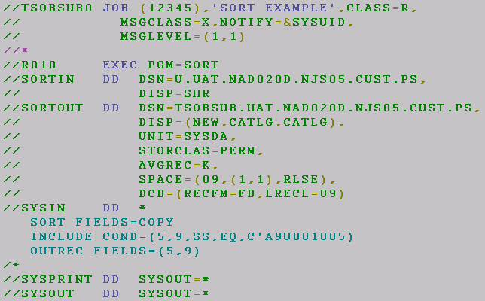
Sample JCL for SORT processing

Slide 9
SORT processing order
The processing order (Priority) of the control statements by SORT is as follows.
    1. INCLUDE or OMIT conditions.
    2. INREC statement.
    3. SORT, MERGE or COPY.
    4. SUM statement.
    5. OUTREC.
  The processing order will drastically change if OUTFIL statement is present in the SYSIN of SORT.

Slide 10

Any questions so far ??

Slide 11
Tips

Slide 12
Introduction
SORT is capable of performing various functions beyond sorting.
This presentation highlights a few of those features, which might come in handy for ad-hoc requests. These features essentially replace one-time codes effectively.
The below presentation will help the developers to do the following : -
  1) Sub-set search.
  2) Find & replace
  3) Fields comparison
  4) Mask Patterns

Slide 13
Subset search
What is it –
    To select the record (s) which contains a particular string pattern in the input record at given position.
  How to Use –
      To use the Substring Search you must define each INCLUDE separately like this:
      INCLUDE COND=(215,32,SS,EQ,C‘XXXXXX')
        SS = is the Substring Search condition.
  Two types of substring comparison tests are offered, as follows:
    Example-1
      Finding a constant value.
      INCLUDE COND=(215,6,SS,EQ,C‘OK')
    How it Works - If the search value is 'OK‘ , then C'**OK**' or C'****OK', are selected and C'**ERR*‘ will be omitted.

Slide 14
Subset search
Example-2 ( Find a field value within a constant (s) )
  Suppose you want to select only the books for the Biology, History, Business you can select those books using this INCLUDE statement:
INCLUDE COND=(106,5,CH,EQ,C'BIOL ',OR,
    106,5,CH,EQ,C'HIST ',OR,
    106,5,CH,EQ,C'BUSIN')
  If you want to include more books, then more typing is required to do. Instead, you can use substring search capabilities of INCLUDE and OMIT to write the statement in a simpler form as:
  INCLUDE COND=(106,5, SS,EQ,C'BIOL ,HIST ,BUSIN,MATHS')
  The length of each string must match the length of the field. Because the Dept is 5 chars, you must add a blank at the end of “BIOL” and “HIST”, which are each four characters, which is not applicable for “BUSIN” and “MATHS“.

Slide 15
Fields comparison
What is it –
    To select all records which contain same data in different positions (Fields) of the file.
How to Use –
    To use the Field comparison you must define each INCLUDE separately like this:
    INCLUDE COND=(Field1,EQ,Field2),FORMAT=XXX
  Example-1
      INCLUDE COND=(100,8,EQ,200,8),FORMAT=PD
  How it Works -
      Field (100 - 08) → Is Price field (F1)
      Field(200 - 08) → Net-amount field (F2).
      The above control card will return all the records only if F1 = F2.

Slide 16
Find & Replace
What is it –
    Using the CHANGE and NOMATCH parameter of the OUTREC statement, you should be able to change one string to another provided you know the exact positions of the strings.
    Using inrec and outrec it is possible to replace characters and fields.
  How to Use –
      OUTREC (start, length, change=(length,
      find,set,...),
      [nomatch=(set |start,length)]
      When doing search and replace, which can be specified anywhere in a normal inrec or outrec instruction.
      You can begin as usual by giving the starting position and the length of the field.
      Next you specify the length of the field to appear in the reformatted record.

Slide 17
Find & Replace
    After this, specify a number of the find set pairs, i.e. the find value and it is replacing value.
    If none of your find strings match, the value in NOMATCH should be included.
    This can be either a constant or a section of the input record.
    If the NOMATCH string is shorter than the length of the change string it will be padded to the right with blanks or low-value.
    NOMATCH is optional, but if it is omitted and an unmatched condition is encountered, SyncSort will abend with U0016 RC.
How it Works -
    Consider the following - containing pet information with the pet name in positions 1-8, the gender (M or F) in position 9, and the species (D = dog, C = cat, R = rabbit) in position 10:

Slide 18
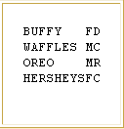
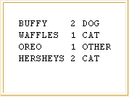
Find & Replace
    Let's assume you desire the following output with the name remaining in positions 1-8, a blank in position 9, the gender (recoded as 1 = male, 2 = female) in position 10, a blank in position 11, and the species (spelled out as DOG, CAT, or OTHER) in positions 12-16.

Slide 19
Find & Replace
Sort control cards would appear as follows:
  //SYSIN DD *
  SORT FIELDS=COPY
  OUTREC FIELDS=(1:1,8, NAME
9:1X, BLANK
10:9,1,CHANGE=(1,C’M’,C’1’, RECODE GENDER
C’F’,C’2’),
11:1X, BLANK 12:10,1,CHANGE=(5,C’D’,C’DOG’, RECODE SPECIES C’C’,C’CAT’), NOMATCH=(C’OTHER’))

Slide 20
Find & Replace
Let's quickly explain the last field:
  12 is the position in the output record, 10 is the position in the input record, 1 is the length in the input record, 5 is the length in the output record, C'D' and C'C' are the change-from values, and C'DOG ' and C'CAT ' are the change-to values.
  Note the NOMATCH operand is optional (it wasn't used with gender), but if it is omitted and an unmatched condition is encountered, SyncSort will abend with U0016 return code.
  As always, be careful of misplaced blanks, commas and parentheses.
  Proper alignment is not required by SyncSort, but may be required by your peers!

Slide 21
Quick questions - I
How the below INCLUDE statement will work & what happen if the search string is starting at position 35. INCLUDE COND=(1,20,SS,EQ,C'INTRODUCTION')
Can we use Sub-string search in OMIT?
Yes
Is NOMATCH mandatory?
No
What happen if an unmatched condition occurred?
SORT will fail with RC U0016
Only equality condition can be used in field level comparisons. True/False
False

Slide 22
Quick questions - I
Both INCLUDE and OMIT can be given in the same SORT control card. True/False
False.
What will happen, if the length of the any sub-strings in sub-string search set is different?
Space will be padded.
Un-sorted data can be also merged?
False.
Duplicate records will be retained while MERGE?
True.
Is it possible to sort multiple fields with different sequence?
Yes

Slide 23
Mask Patterns
What is it –
    Package Decimals values are stored as integers in a compressed internal format that is actually unreadable if you print or display the values
    Mask Patterns used to do re-formatting on the numeric data into printable format , so they can be easily interpreted.
How to Use –
    You can use the edit features of the OUTREC statement to display the PD values as readable characters.
    Furthermore, you can use the edit features to insert signs, commas, decimal points and hyphens, as appropriate, to make the Packed Decimal values easy to interpret.

Slide 24

Mask Patterns
Input date
    WEST 115900 +05122003
    EAST 226800 +11292003
    NORTH 337600 +02152004
    SOUTH 448300 +12032003
  Col 01 – 05 → Regions.
  Col 08 – 13 → Numeric field.
  Col 16 – 24 → Packed decimals.
Expected output
    WEST $115,9.00 + 5/12/2003 05/12/2003
    EAST $226,8.00 + 11/29/2003 11/29/2003
    NORTH $337,6.00 + 2/15/2004 02/15/2004
    SOUTH $448,3.00 + 12/03/2003 12/03/2003

Slide 25
Mask Patterns
You can use the following OUTREC statement to make the PD values meaningful:
  SORT FIELDS=COPY
    OUTREC FIELDS=(1:1,5,
    5X,
    11:8,6,ZD,EDIT=($III,I.IIS), SIGNS=(,,+,)
    5X,
    25:16,9,ZD,EDIT=(II/II/IIII),
    5X,
    41:16,9,ZD,EDIT=(TI/TI/IIII))
    /*

Slide 26
Mask Patterns
How it Works -
  EDIT=($III,I.IIS) is a user-defined edit mask. It edits a numeric field according to the pattern $123,4.00 +
  EDIT=(II/II/IIII) is another user-defined edit mask with zero suppression.
  EDIT=(TT/TT/TTTT) is another user-defined edit mask without zero suppression.
Patterns in EDIT statements:
  I indicates a leading insignificant digit. If zero, this digit will not be shown.
  T indicates a significant digit. If zero, this digit will be shown.
  S indicates a trailing/leading sign.

Slide 27
Mask Patterns
How it Works -
  Signs=(lp,ln,tp,tn)
    lp is the leading-positive sign character
    ln is the leading-negative sign character
    tp is the trailing-positive sign character
    tn is the trailing-negative sign character
Eg: signs=(,,,-) indicates that only the trailing negative sign is displayed.

Slide 28
Mask Patterns
The 26 pre-defined edit masks can be represented as follows:
  If these pre-defined edit masks are not suitable for presenting your numeric data, the EDIT parameter gives you the flexibility to define your own edit patterns.

Slide 29
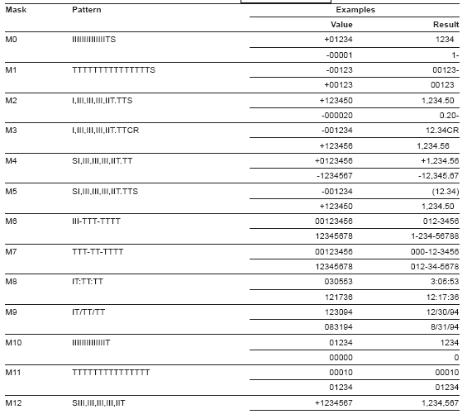
Predefined Mask Patterns

Slide 30
Unsigned Free Format
What is it –
    Decimal digits (0-9) are extracted from right to left to form a numeric value.
    All non-decimal digit values in the field (such as . , $ , comma) are ignored.
    A maximum of 31 digits can be provided. When more than 31 digits are found in the field, the leftmost digits will be ignored.
How to Use –
    Use UFF in INREC or OUTREC

Slide 31
Unsigned Free Format
Sample Input
  22.30
  $100,120,956,66.23434
Example:
  SORT FIELDS=COPY
  OUTREC FIELDS=(1,30,UFF)
Expected Output
  2230
  1001209566623434

Slide 32
ALTSEQ
What is it –
    It change the collating sequence of EBCDIC data. It changes only the order of data and not the data itself.
    When you supply an ALTSEQ statement in SORT, it applies the modified collating sequence to a field. Provided, format should be AQ.
    If you specify AQ without supplying an ALTSEQ statement, SORT uses the default available at your OS or standard EBCDIC collating sequence.
How to Use –
    Provide all the collating sequence in ‘CODE’ statement.
      It consists of both original and modified collating sequence.

Slide 33
ALTSEQ – Using CODE
Example1 –
  ALTSEQ CODE=(5BEA)
      The character $ (X'5B') is to collate at position X'EA‘, that is, after uppercase Z (X'E9').
Sample I/p -
  A C Z * B $
With actual char SORT i.e., “SORT FIELDS=(1,1,CH,A)”. The expected output will be
  $ * A B C Z
Using ALTSEQ in SORT i.e., “SORT FIELDS=(1,1,AQ,A)”. The expected output will be –
* A B C Z $

Slide 34
ALTSEQ – Using TRAN
Example 2 –
  To convert low-values in a record to spaces, we can use ALTSEQ as follows:
  SORT FIELDS=COPY
    ALTSEQ CODE=(0040)
    OUTREC FIELDS=(1,80,TRAN=ALTSEQ)
How does it work –
    ALTSEQ CODE=(0040) indicates the ‘from’ hex value as ’00’, which is a low-value, and the ‘to’ hex value as ’40’, which is a space.
    TRAN=ALTSEQ converts all the ‘from’ hex values, in the given position range, to the ‘to’ hex values.

Slide 35
Quick Questions - II
What will the output of the Sort card → OUTREC FIELDS=(1,30,UFF) for the below record is:-
VOIP OF TEST12 IS: 612-4862
Expected output → 126124862
What will be the output of the below record with Sort card:
OUTREC FIELDS=(1,4,UFF,EDIT=(TTTT))
0120120120
Expected output → 0120
How do you convert spaces to low-values in a file?
Using ALTSEQ. ALTSEQ CODE=(4000)
ALTSEQ can convert only spaces to low-values and vice-versa - True/False?
True

Slide 36
Quick Questions - II
What does SIGNS=(+,-,,) signifies?
Leading positive & negative will be displayed and trailing positive & negative will be spaces.
How to format the phone number in the below format (Area-code) – (Phone Number) i.e. (0413) – (2356410)
EDIT=((TTTT)-(TTTTTTT))
Is it possible to remove the duplicates via SORT, if yes how?
Yes, Using SUM FIELDS=NONE
Can we use Mask Patterns for text/string?
No
Can we provide Sort control is PS instead of SYSIN DD *
Yes

Slide 37



For more details
Balamurugan Subramanian
BaSubramanian@inautix.co.in
Voip – 4862

